Slide 1
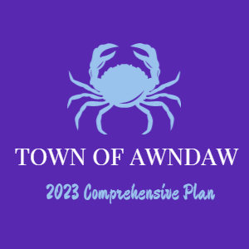
Town of Awendaw 2023 Comprehensive Plan
A 10-Year Plan for Our Town and Our Way of Life

Slide 2
Steering Committee Agenda
What is a Comprehensive Plan?
Process and Timeline
Top Ten Principles for Awendaw

Slide 3
What is a Comprehensive Plan?
Identify and communicate the County’s collective vision and goals for the future
Identify and communicate the Town’s collective vision and goals for the future
Provide a blueprint for future land use decisions
Provide a blueprint for future land use decisions
Form a basis for land use codes, zoning, subdivisions, etc.
Form a basis for land use codes, zoning, subdivisions, etc.
Illustrate concepts, ideas and data with a combination of text, maps, and graphics
Illustrate concepts, ideas and data with a combination of text, maps, and graphics
Offer a menu of implementation strategies and ways to measure success

Slide 4
State Comprehensive Planning Requirements
1994 State Comprehensive Planning Enabling Act mandates a comprehensive planning process and update every 10 years, to include:
Inventory of existing conditions
Assessment of ten required “elements”
Statements of needs, goals and objectives
Implementation strategies and timeframes

Slide 5
Population
Community Facilities
Ten Required Elements
Economic Development
Housing
Natural Resources
Land Use
Resilience
Transportation
Cultural Resources
Priority Investments

Slide 6
Process Timeline
March-May, 2023
May –
July 2023
July – September 2023
Public Engagement/
Open House
Needs Assessment
Progress Reports to PC & CC
Steering Committee Engagement
Research of Existing Conditions
Develop Goals & Action Plan
Draft Document Production/
Final Plan Public Hearings

Slide 7
Top Ten Principles for Awendaw 2023
1
Community Character. The Awendaw Community is dedicated to preserving, enhancing, and restoring the Town’s character as a rural, coastal, and forest community.
2
Rural Lifestyle. The Awendaw Community recognizes and supports the fishing, wildlife, and forest lifestyles including the historic Gullah/Geechee people of the Town as unique and defining attributes.
3
Natural Environment. The Awendaw Community seeks to preserve, protect, enhance, and restore the Town’s riparian corridors, woodlands, and wetlands to protect its wildlife and natural habitat, and to maintain its scenic bay vistas and tranquil environment

Slide 8
Top Ten Principles for Awendaw 2023
Built Environment. The Awendaw Community believes that the built environment should be subordinate, sensitive, and complementary to the natural environment, setting, and, specific site conditions to minimize disturbance to terrain, and visual resources, and protect open space. The Community supports low-country architectural and site design requirements that set forth community expectations and ensure quality development.
Rural Density. The Awendaw Community strives to avoid the suburbanization of its Town by limiting rural residential density to a maximum of four units per acre in the densest locations on major roadways and then decreasing sharply as you move toward town peripheries. Planned communities will incorporate considerable open space and natural areas into their designs.
Circulation. The Awendaw Community promotes safe and convenient circulation for all modes of travel throughout the Town; on Town roads, trails and paths.
4
5
6

Slide 9
Top Ten Principles for Awendaw 2023
7
Commercial Services. The Awendaw Community desires commercial services and facilities which meet the frequently recurring needs of the residents and the occasional needs of highway travelers. The Community feels that a key economic driver for the sustainability of the Town will be eco-tourism and businesses that support this endeavor.
Safety. Awendaw strives to protect persons and property from unreasonable exposure to natural hazards, such as hurricane activity, fire, unstable terrain, storms, and flood, by continuously improving regulations, policies, and procedures to reflect current best management practices.
Community Culture. Awendaw favors a community culture that encourages citizen involvement, individual expression, and diversity, and recognizes the interdependence of neighboring communities and responsibility as good citizens within the region, State, and nation.
8
9

Slide 10
Top Ten Principles for Awendaw 2023
10
Sustainability. The Awendaw Community seeks to be a good steward of the land. The goal is to promote the conservation of resources and utilize sustainable practices which recognize the connection to, and interdependence with, the natural environment.

Slide 11
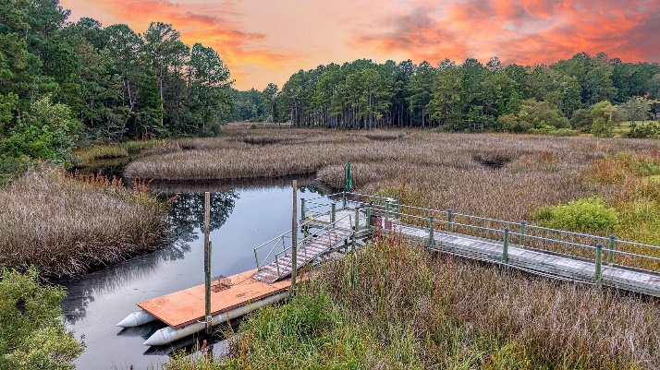
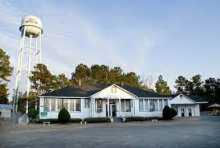
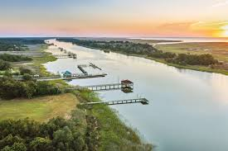
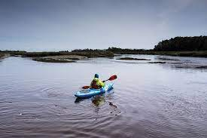
Q&A Open Discussion
What has the Town gotten “right” in implementing the 2017 Plan?
What needs more attention?
What are the Town’s biggest challenges going forward?
Population?
Housing?
Traffic?
Economics?
What opportunities exist for the Town’s future?

Slide 12
Next Steps
Refine Guiding Principles
Data Collection & Needs Analysis
Formulate Goals and Objectives

